Slide 1

BC2410, Prescriptive Analytics From Data to Decisions
A Brief Review of Lecture 5

Slide 2

Office Hours

Slide 3
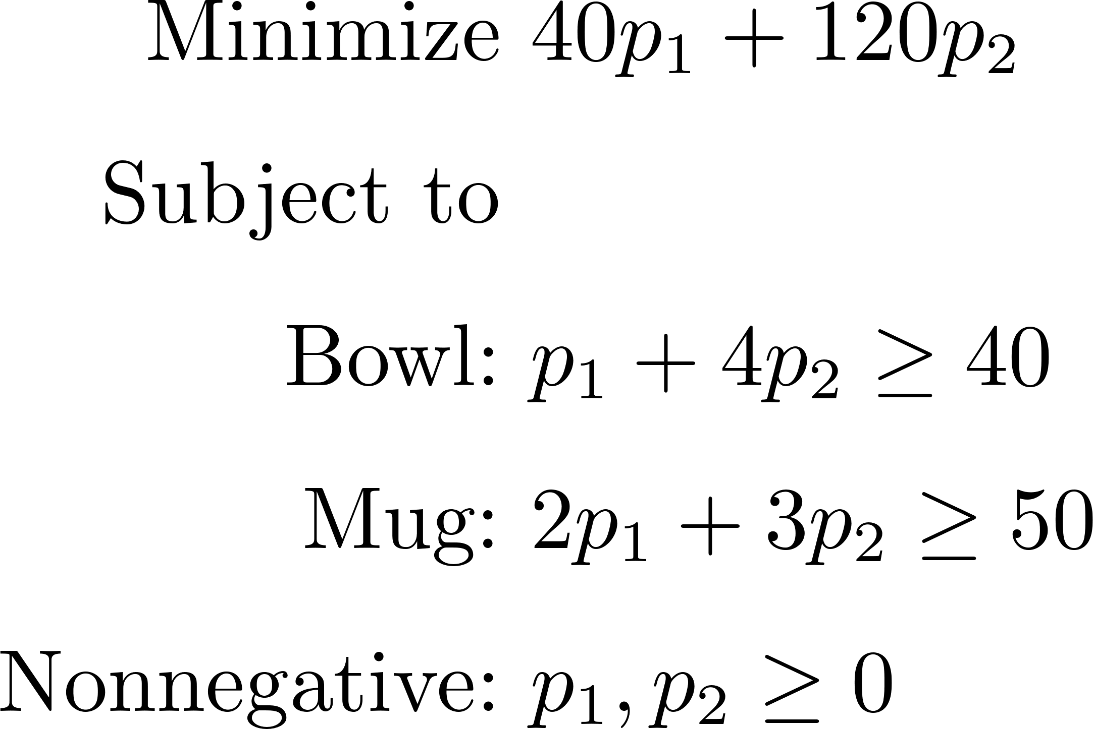
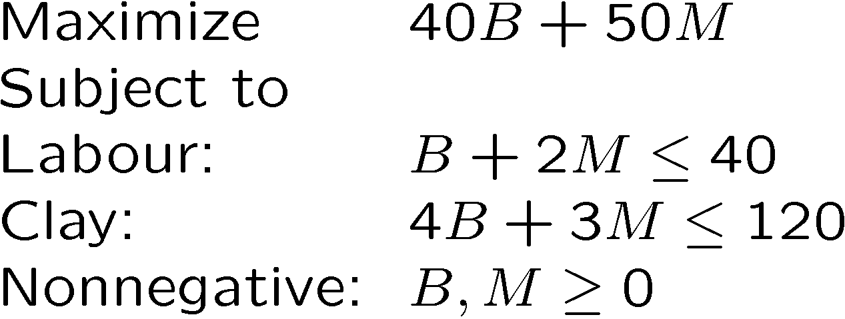
Economic Interpretation
Primal
Dual
Manager optimizes revenue in primal problem.
Manager could sell his LABOUR and CLAY to a Buyer.
Dual Constraints:
Prices for LABOUR and CLAY that Manager would be stupid to refuse.
Rewards from selling each item, should be less than revenue received from selling the components to assemble the item.
Dual Objective:
Lowest cost to the Buyer.
Strong Duality:
Manager’s best revenue is the same Buyer’s lowest costs.

Slide 4
Implication of Strong Duality
How to compute shadow price?
How would objective value change when b₁ increases by 1 unit, assuming the dual problem remains optimal?
What is the Shadow Price of a constraint that is not binding?
Implications of Complementary Slackness.

Slide 5
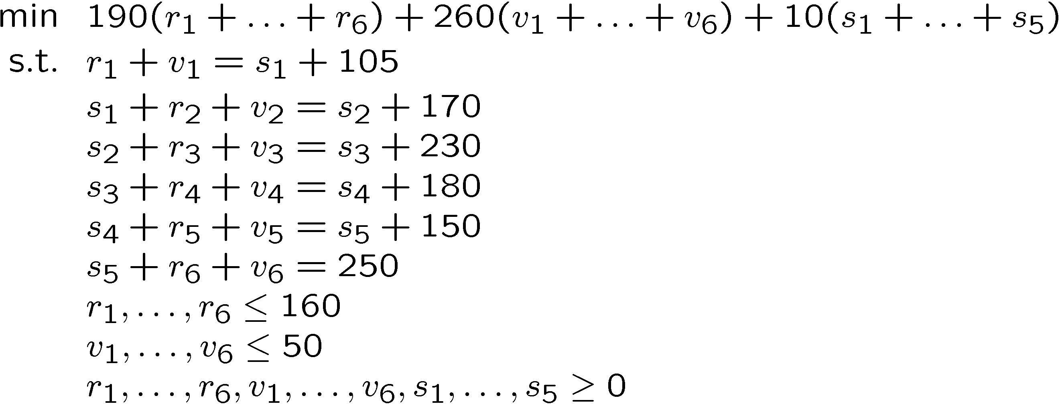
Exercises

Slide 6
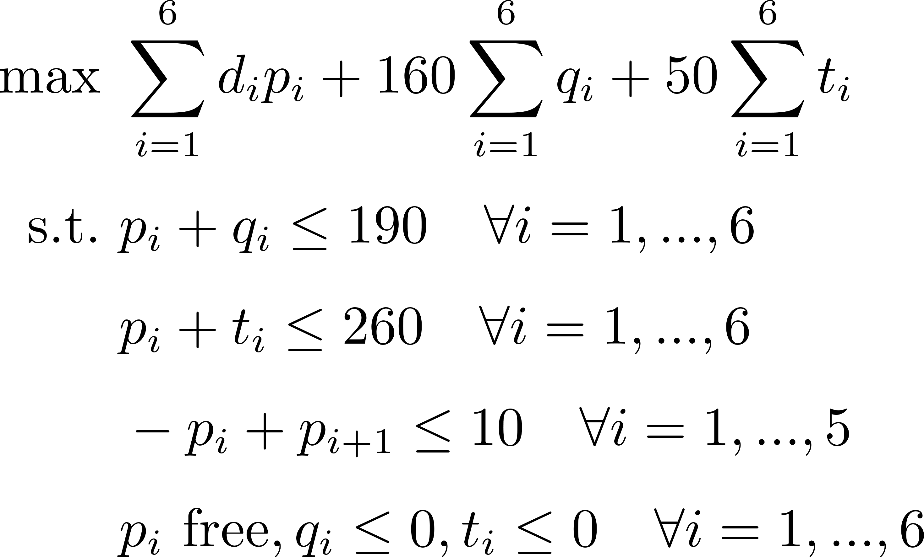
Exercises

Slide 7
Exercises

Slide 8
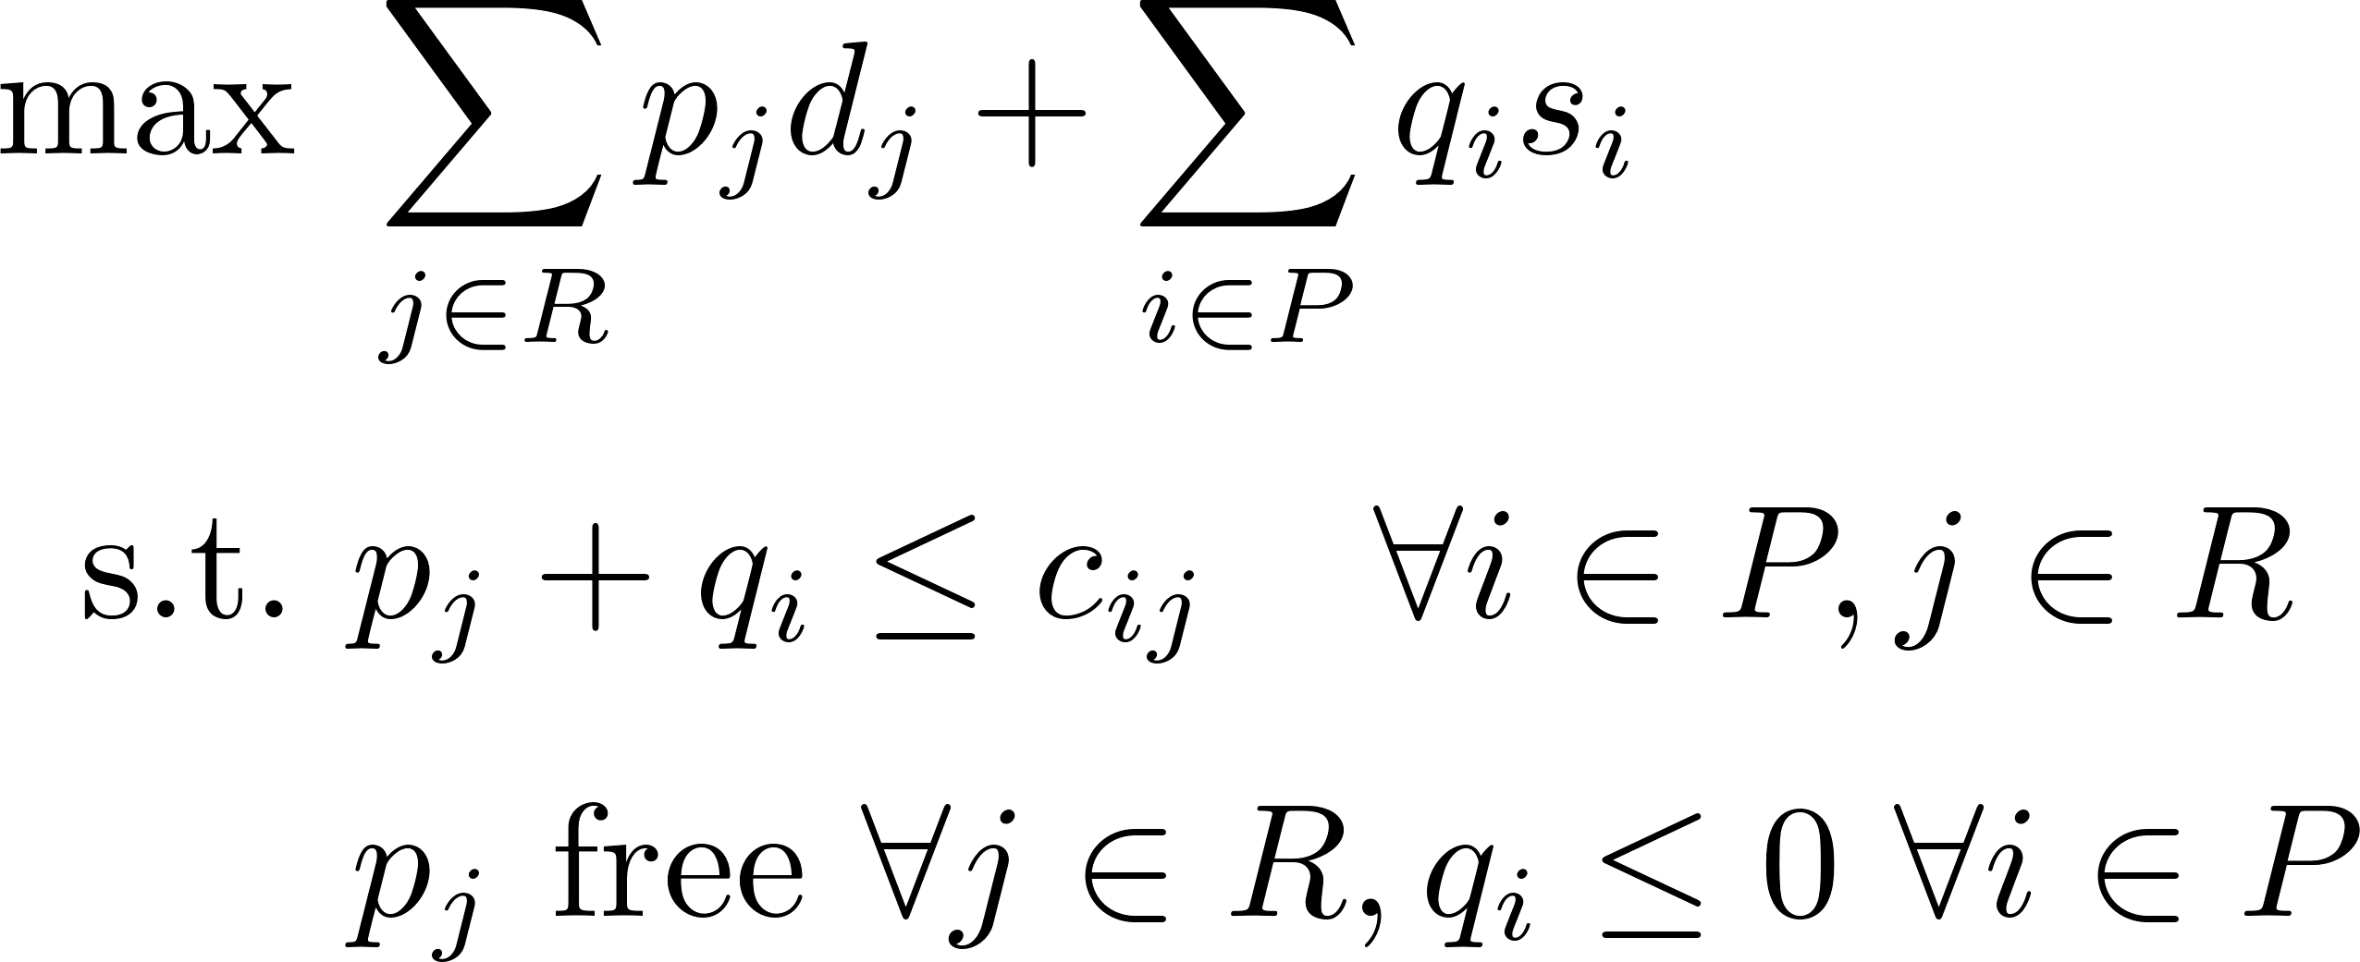
Exercises

